Slide 1

CSE- 322
Software Engineering Lab
Lab: 01
Fahad Ahmed
Lecturer, Dept. of CSE
E-mail: fahadahmed@uap-bd.edu

Slide 2
Course Synopsis
The material presented in this course is intended to acquaint students with some of the elementary software testing methods, tools and techniques currently being used by different software testing organizations in the industry. Students learn and apply different Black Box software testing tools followed by some ideas on White Box testing as well. As the tools for Black Box Testing, Selenium, QTP etc tool will be used and necessary platforms and language essentials, if necessary to complete the task, are demonstrated to the students. For testing purpose, students use the same software projects those they have developed in these lab. Black Box Testing tools are not limited to the mentioned ones and can be designed as course instructor wants to.

Slide 3

Google class room code

Slide 4
Project Groups
Project group
maximum 3 members**

Slide 5
CO-PO
CO No. | CO Statements: Upon successful completion of the course, students should be able to: | Corresponding POs
CO1 | Apply the Engineering knowledge to provide a working solution on a complex engineering problem and submit a mapping of the solution. | a-Engineering Knowledge
CO2 | Identify functional and non-functional requirements of the proposed solution considering based on requirement analysis. | b-Problem Analysis
CO3 | Develop a working solution for proposed software-intensive systems and verify, validate the solution using the industrial state of the practice, which indicates a high-quality software-intensive system. | c-Design/ development of solutions
CO4 | Use a modern/popular IDE to test complex software-intensive systems. | e-Modern Tool Usage
CO5 | Assess societal, health, safety, legal and cultural issues related to the project. | f-The Engineer and Society

Slide 6
CO-PO
CO No. | CO Statements: Upon successful completion of the course, students should be able to: | Corresponding POs
CO6 | Practice professional ethics and Responsibilities and norms of engineering practice. | h-Ethics
CO7 | Work as a team and fulfil individual responsibility. | i-Individual and Team work
CO8 | Communicate effectively through presentation and write effective reports and documentation on the project. | j-Communication
CO9 | Apply project management principles using Version Control System, and predict project operating cost, and financial risk analysis for complex software-intensive systems. | k-Project Management and Finance
CO10 | Recognize the need for, and have the preparation and ability to engage in independent and life-long learning for art of project management, distributed and collaborative software development and risk analysis for developing complex software-intensive systems. | l-Lifelong learning

Slide 7
Weighting COs with Assessment methods
Will be changed
Assessment Type | % weight | CO1 | CO2 | CO3 | CO4 | CO5 | CO6 | CO7 | CO8 | CO9 | CO10
Presentation | 10% |  | 5 |  |  |  |  |  | 5
Report (video+ word/pdf)+ CEP Mapping | 50% | 5 mapping | 5 | 5 (video demo)+ 15 report Testing |  | 5 | 5 |  | 5 | 3 | 2
Viva | 18% | 5 |  |  |  |  | 5 | 5 |  |  | 3
Continuous Project Evaluation | 22% |  |  | 10 | 5 ide use |  |  | 5 |  | 2
Total | 100% | 10 | 10 | 30 | 5 | 5 | 10 | 10 | 10 | 5 | 5

Slide 8
PO Attainment
Final Year Project
Final Year Project
Final Year Design Project
Final Year Thesis-Project
Final Year Courses
Final Year Courses
Third Year Courses
Third Year Courses + Course Projects
Second Year Courses
Second Year Courses
Knowledge and Skills
First Year Courses
First Year Courses

Slide 9
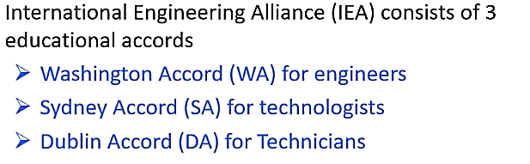
IEA and CEP
According to Washington Accord
Knowledge Profile (K)
Level of Problem Solving(P)
Attributes(A)

Slide 10
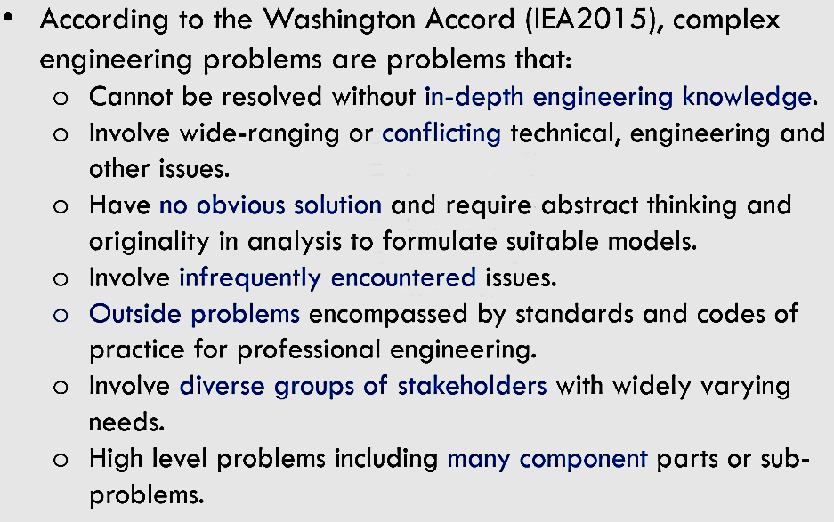

Complex Engineering Problems
How to Demonstrate through Projects?

Slide 11
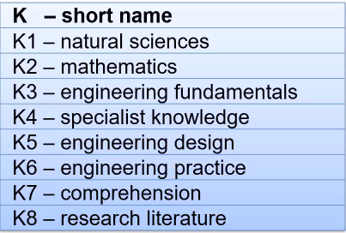
Complex Engineering Problems :
Knowledge Profile (K)

Slide 12
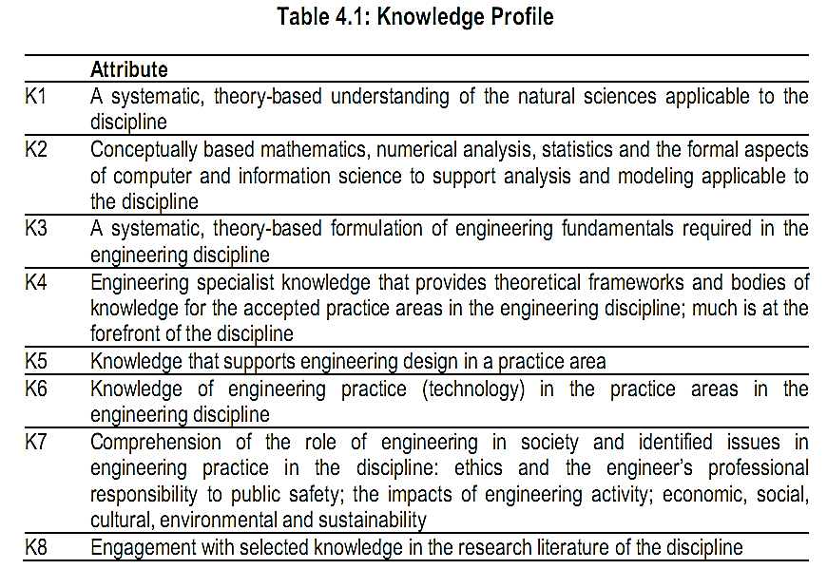
Complex Engineering Problems

Slide 13
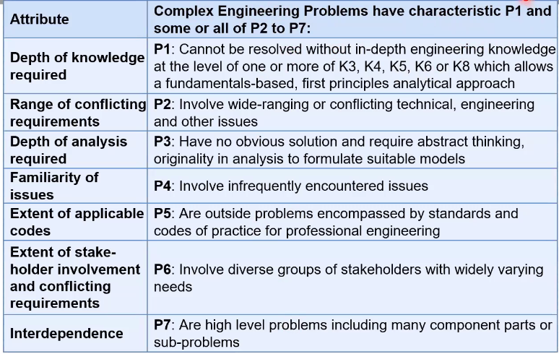
Complex Engineering Problem Solving (P)

Slide 14
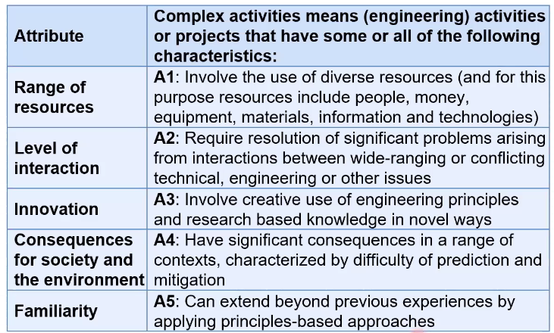
Complex Engineering Activities (A)

Slide 15
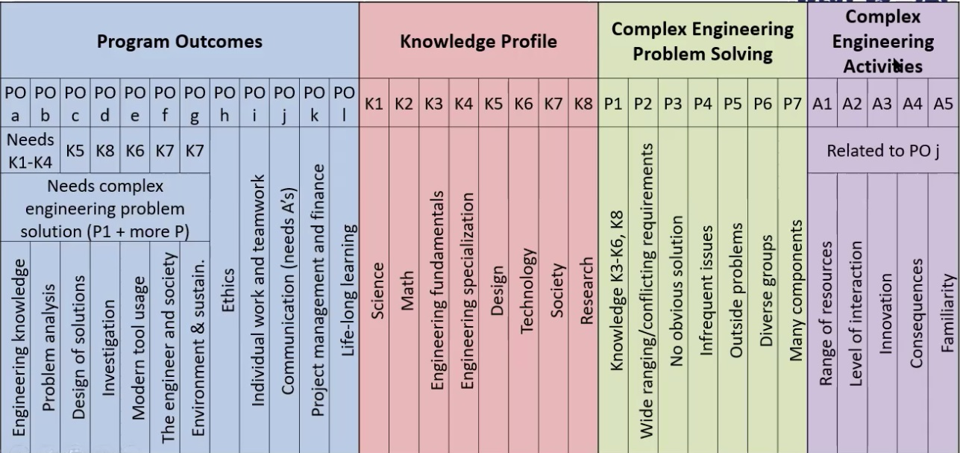
Complex Engineering Problems

Slide 16
Project Idea
This are not complex engineering problem (CEP), try to make it into CEP
https://nevonprojects.com/year-projects-for-computer-engineering/
https://1000projects.org/

Slide 17
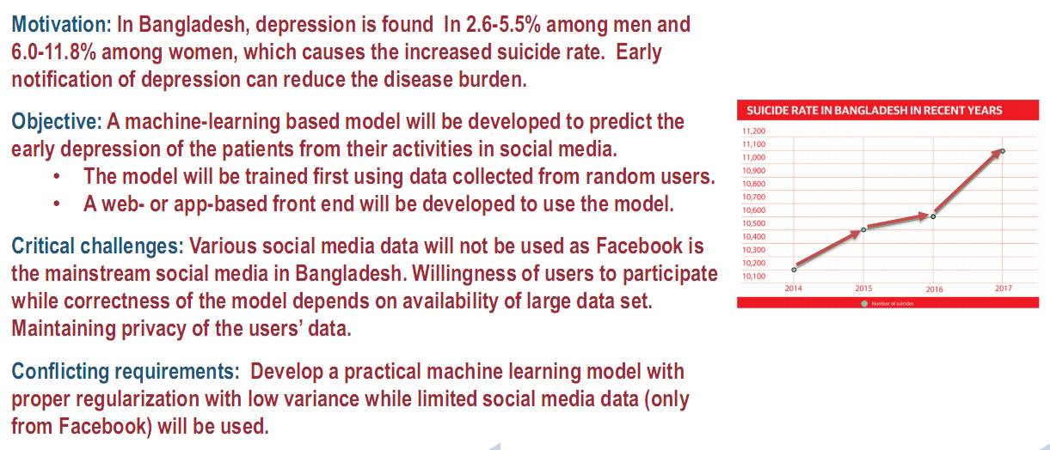
Complex Engineering Problem

Slide 18
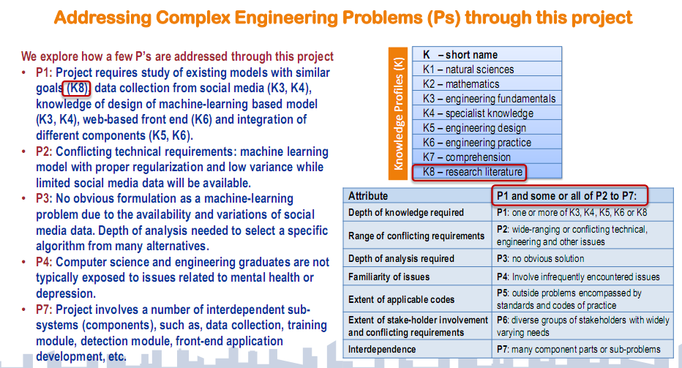
Complex Engineering Problem

Slide 19
Complex Engineering Problem
Design a simple Bangla Speech Recognition system.
Such a system can be incorporated with a wheelchair to make it voice controlled and thus enables a physically handicapped person to move freely without the help of a constant care-giver. Moreover, the ability to give commands in Bangla will make the system more user-friendly in the context of Bangladesh.
The system should be speaker-independent, i.e. it is required that the Bangla speech recognition system should work satisfactorily irrespective of sex, age-group, or dialect of the speaker.
Students are required to explore different methodologies to investigate the problem through design of experiment and data analysis and select or develop an optimal methodology for design of the system.

Slide 20
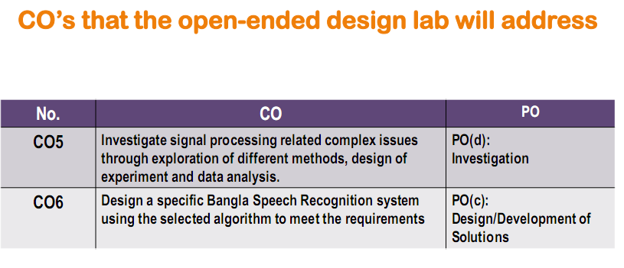
Complex Engineering Problem

Slide 21
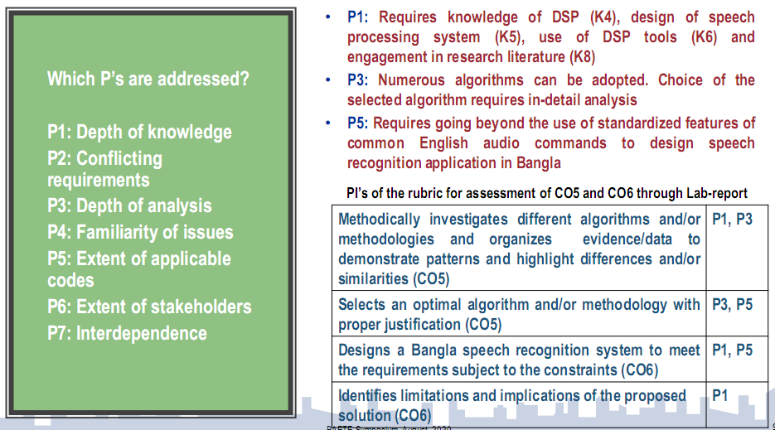
Complex Engineering Problem

Slide 22
Project Proposal (Next lab)
Project Title
Project Member’s
{ version control system profile}
Problem Definition
Objective
Solution & Project Outputs (web-app, mobile app/ cross platform/ game)
Requirement analysis (functional according to SRS)
Impact on Society
Project Management (Time-table – grantt chart)
Project cost
How P and K s are addressed through the project and mapping

Slide 23

Thanks to All

